Slide 1
Software Security Tools

Slide 2


Categories of Tools
Passive
Observe network traffic
Monitor network comings and goings
Watching to see that things are secure
Active
Interact with network traffic
Query devices, monitor response
Attempt known vulnerabilities
Check account access
Actively engaging, checking doors and windows. Verifying things are secure

Slide 3
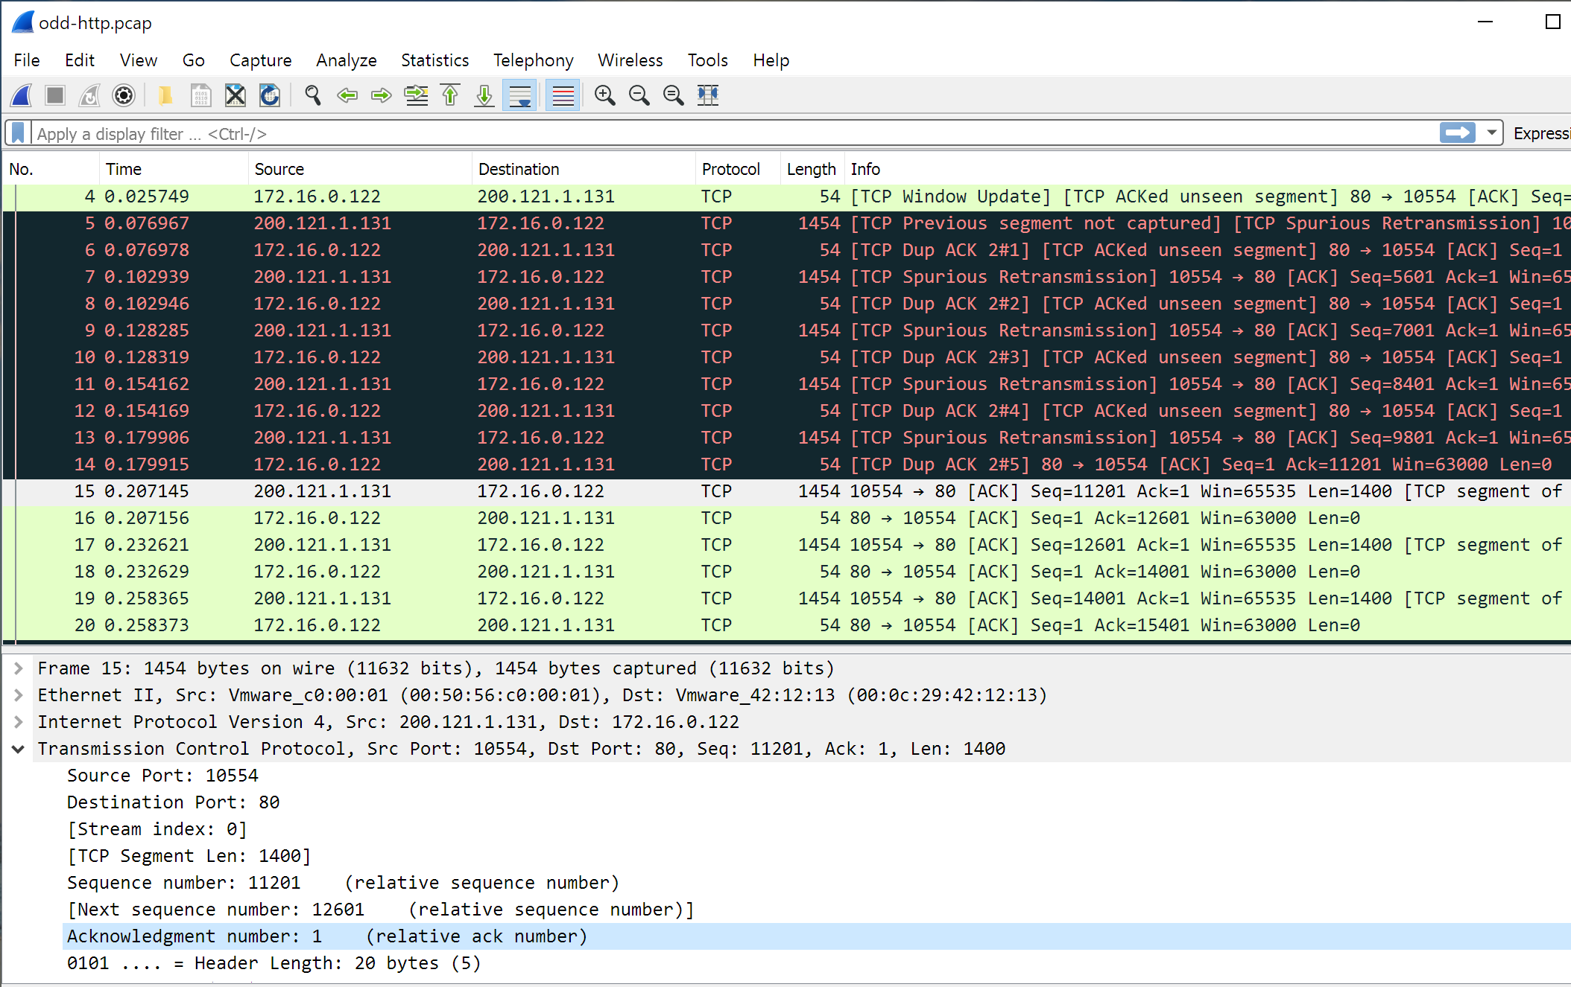
Protocol Analyzer
Watch packets live on the network (or replay later)
Monitor traffic
Identify unknown traffic
Verify packet filtering and security controls
Examine how apps are communicating

Slide 4
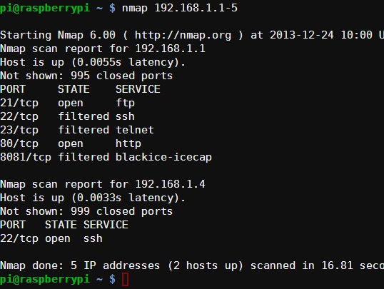
Network Scanners
Search for hosts on a network
Scan range of IP addresses
Rogue system detection (“Wait, who is that IP address?”)
Scan for open ports on host
Identify services available on a host
Fingerprint operating systems
“What’s OS is behind that IP?”

Slide 5
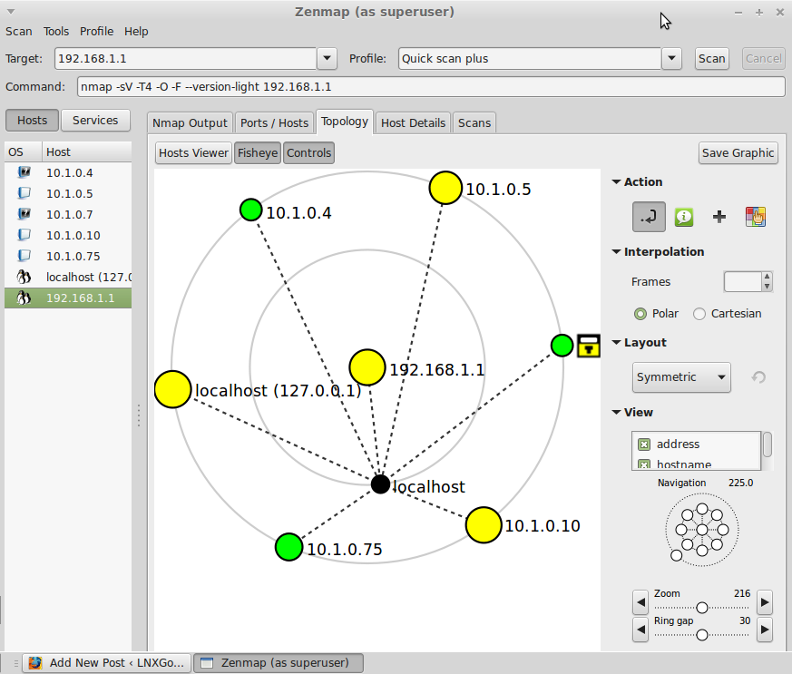
Graphical Network Scanners
Visually map the network
Rouge system detection
Easier to spot graphically
Monitor hosts on network
Visualize traffic patterns

Slide 6

Wireless scanners and crackers
Wireless monitoring
Packet capturing
Wireless attacks
Rogue access point, deauthentication attacks, etc.
Cracking
Find a wireless network key
WEP – Cryptographic vulnerabilities – relatively straightforward
WPA PSK and WPA2 PSK – Dictionary brute force, rainbow tables
Examples:
aircrack-ng, kismet, netstumbler, airsnort

Slide 7
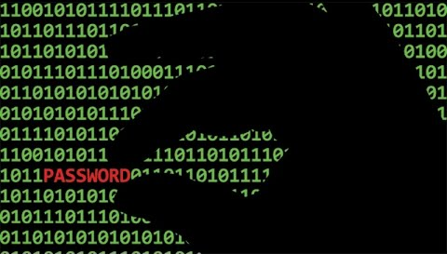
Password Crackers
Passwords are stored as hashes
Grab copy of the hashes, crack offline
Use known, common passwords from a wordlist
Use rainbow tables
Pre-calculated hashes, based on system (SQL, Linux, Windows)
Password salting can combat rainbow tables
Security professionals audit user passwords using same tools as hackers would
Find and fix problem before it can be exploited
Examples:
John the Ripper, Ophcrack

Slide 8

Vulnerability scanners
Minimally invasive
Probes system for weaknesses
Network, host and application vulnerability scanners
Checks for missing security patches, misconfigurations, old exploits
Examples:
Tenable Nessus [network-based]
Microsoft Baseline Security Analyzer (MBSA) [host-based]
Nikto [application-based]

Slide 9

Configuration compliance scanners
Security Content Automation Protocol (SCAP)
Provides common platform for reporting
Not all scanners are SCAP-compliant
Check various configurations
Establish baseline configurations
Scans to report systems not in compliance

Slide 10


Exploitation frameworks
Some attacks require multiple steps to exploit
Framework provides recipe or checklist of steps
Example frameworks
Metasploit – Build vulnerability tests from exploit database
BeEF – Browser Exploitation Framework Project
RouterSploit – Router Exploitation Framework

Slide 11

Data sanitization tools
“Delete” doesn’t always mean it
When you delete a file, it’s not always gone
Storage devices usually flag memory as “available” (able to be overwritten)
Forensics experts can still retrieve overwritten data (magnetic shadows)
To truly delete something, must overwrite several times
Examples
Darik’s Boot and Nuke (DBAN)
Microsoft sdelete

Slide 12

Steganography tools
From Greek words for “concealed writing”
Message is hidden to the casual viewer
The cover text
The document or file that will contain the message
Network-based steganography
Embeds message in obscure parts of TCP packets
Image-based
Embed message in an image
Relies on exploiting image compression algorithms (JPG, PNG)

Slide 13

Steganography techniques
Invisible watermarks
Machine Identification Codes
Tracking dots on printers
Reveal serial number and timestamp of print job
Thwart counterfeit documents
Case: Google copied music lyrics from Genius without consent
Genius proved Google copied their lyrics by embedding messages with ‘ and ` marks (similar but different) and different types of spaces.
When read as long/short (as letters in Morse Code) message spells out GENIUS and REDHANDED
Notes:
Machine Identification Codes
https://worldofsecrets.org/en/2015/10/machine-identification-code-mic/
https://en.wikipedia.org/wiki/Machine_Identification_Code
Lyric Copying
https://www.pcmag.com/news/369045/genius-we-caught-google-red-handed-stealing-lyrics-data

Slide 14

Honeypots
Server that acts like real, intended target server
Keeps hackers busy, away from real target
No real, valuable information on honeypot
Constantly have to question what’s real and what’s the fake
Wastes their time, efforts
Activities logged for further study
Shows what attackers are attempting to do
Allows admins to then take specific steps to protect from those particular attacks

Slide 15

Backup utilities
Protected from unexpected downtime
Malware/ransomware
Corrupted OS/file system
Incremental backups
Tracks changes since last full backup
Hourly, Daily
Full backups
Complete file backups
Daily, Weekly
Store backups off site in case of physical calamity
Notes:
Maersk recovering from the world-wide NotPetya cyber attack – all their servers were offline. Backup servers. All files were encrypted.
One, lone Maersk office in Ghana had their Primary Domain Controller’s backup. It was not affected. Maersk used that data to rebuild their network.

Slide 16
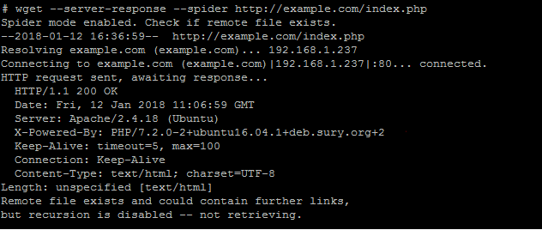
Banner grabbing
Applications sometimes give status messages that expose exactly what software it is running
Application name, version, optional modules, etc
Info used to seek out exploits specific to that system
Examples
telnet
netcat
curl/wget
dmitry

